Slide 2
What is Brook?
Brook supports young people to have healthy lives. We provide help for young people with problems and questions about their bodies and relationships.
Notes:
Introduce Brook – some suggestions below
Brook is a charity which supports young people to have healthy lives. We provide help and support to young people with problems and questions about their bodies and in their relationships.
We provide education sessions, like this one to give you information which will be useful in your lives now and in the future.
Cover if appropriate for the group:
Our values are:
To be collaborative – We want to work with young people and that young people should be at the centre of decisions that affect them
To be courageous - We push the boundaries when fighting for change, supporting young people to build a society where people are free to explore their identities without stigma.
To be Trailblazing - Since 1964 we have championed the pioneering spirit of our founder, leading the way in meeting the ever-changing needs of young people.
To be Trustworthy- Young people can feel safe to speak freely about the issues that affect them.
https://www.brook.org.uk/wp-content/uploads/2020/06/BR_SR_FINAL_DIGITAL.pdf

Slide 3
Safe Space
Feel happy to join in
Kind and respectful to others
Please no personal questions to the teacher or of each other
Confidentiality & keeping you safe
Try to use the correct names for body parts
Fun
Notes:
TASK - Create a Brook Space – Group agreement/ Group Rules – adapt to be appropriate for the age group
If time allows ask the group for suggestions for a group agreement

Slide 4
Session outcomes
Can correctly name parts of the internal reproductive organs
Understand that everyone’s bodies are different and we should respect this
Can describe key facts about reproduction and pregnancy
Know where to ask for help with questions about their bodies.
Notes:
Facilitator runs through
Don’t worry if your not sure what some of these words mean – that’s what we are going to talk about today
Explain that we are going to talk about our bodies and reproduction.

Slide 5
What do we call…?
Notes:
TASK –
What do we call…?
Method
• Facilitator asks the group to think of all the words and names they have heard the area in between someone’s legs called. You may need to state no swear words/ offensive terms for particular groups.
• Facilitator can choose to ask group to anonymously write these on stick it notes, then stick them on a wall or just call them out.
• Facilitator debriefs, explaining that we are allowed to have different words for our own bodies but it’s important to know the correct names too. We also shouldn’t use offensive words for parts of the body.
Questions
• What is the name for the area between a person’s legs?
• Is it rude to know about your body?
• Does it feel awkward talking about genitals? Why?
Key Messages
• Everyone has genitals on their body, in between their legs. Sometimes these are called private parts or other nick names. It is important to know the correct words for these parts of the body so we can tell someone if we need help or have questions.
•

Slide 6
Genitals and Bodies
It can feel awkward to talk about genitals but it is not wrong or rude to know about our bodies
Everyone’s genitals are slightly different, but broadly speaking they are split into those who have a vulva and vagina and those who have a penis and testicles
Notes:
Key Messages
Sometimes it can feel a bit awkward to talk about genitals because we are not used to talking about bodies and they are our private parts. However, it is not rude or wrong to understand how our bodies work and know the correct words.
•Everyone’s bodies, including genitals, are slightly different. We should respect other people – not tease or laugh at those who are different to us.
•However, genitals are broadly split into two types – girls, and those with a vulva, and boys, and those who have a penis and testicles.

Slide 7
Everyone’s bodies are slightly different
For some people their sex (male/female) does not match their gender
Today we are talking about bodies and not gender
Notes:
Key messages
• Everyone’s bodies, including genitals, are slightly different. We should respect other people not tease or laugh at those who are different to us.
• For some people their biological sex (being male/ female) does not match the gender everyone expected them to be when they were born. This is OK and we should respect how other people feel. Therefore in this lesson, we are going to talk about people’s bodies, not genders.
In other words, you may feel female and have a penis, you may feel male and have a vulva or may feel like a mix of the two. We’ll learn more about this during PSHE.

Slide 8
Label the body
Notes:
Label the body
Method
Facilitator explains that we are going to think about bodies in more detail and understand the correct words for different parts and what they are for. This is linked to reproduction which we are going to think about later in the lesson.
Facilitator shows images of the internal reproductive system, first one then the other on a presentation. Facilitator may choose to have the areas unnamed to see if anyone in the group knows the names, before revealing the answers.
Using the facilitator debrief sheet, questions and keys messages, facilitator explains the names and functions of each element of the internal reproductive system.
Questions
Is everyone’s body the same?
What is the name for the area between a person’s legs?
How can we keep our genitals clean?
Key Messages
Everyone’s bodies, including genitals, are slightly different. We should respect other people not tease or laugh at those who are different to us.
However, genitals are broadly split into two types; girls, and those with a vulva, and boys, and those who have a penis and testicles. These genitalia on the outside of a person’s body connect to the internal reproductive system on the inside of a person’s body.
People’s genitals are very sensitive and it is important to keep them clean by gently washing with warm water or unperfumed soap (no strong perfumed soap). If you have foreskin (skin over the head of your penis) wash gently under it to stop it getting smelly, itchy or sore.
For some people their biological sex (being male/ female) does not match the gender everyone expected them to be when they were born. This is OK and we should respect how other people feel. Therefore in this lesson, we are going to talk about people’s bodies, not genders.

Slide 9
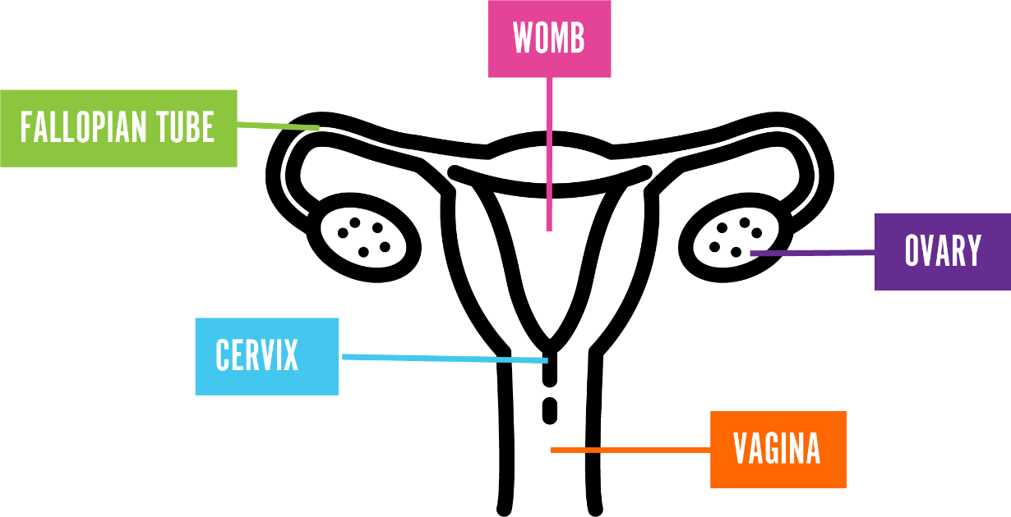
Internal reproductive organs
Womb
Fallopian Tubes
Ovary
Cervix
Vagina
Notes:
Explain that this is what is inside someone’s body who has a vulvas and vagina and is part of the internal reproductive system/ organs
•Ovary – people have two of these and this is where the eggs are stored inside someone’s body. The eggs are needed to help grow a baby and are so tiny you can’t see them with the naked eye
•The fallopian tube- people have two of these. They connect the ovary to the womb.
•Womb – sometime this is also called the uterus. This is where a baby might grow if someone was pregnant
•Cervix – this acts as a barrier to stop anything getting into the body through the vagina. It has a very small hole in it to allow sperm in or period blood out
•Vagina – this is a tube which connects the womb and cervix to the outside of the body.

Slide 10
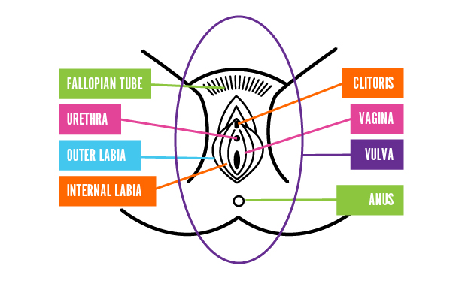
External reproductive organs
Mon Pubis
Clitoris
Urethra
Vagina
Outer Labia
Vulva
Inner Labia
Anus
Notes:
Explain that this is what is inside/outside someone’s body who has a vulva and vagina and is the external view of a vulva.
We often refer to the external genital organs (the bits you can see) as the vagina, but this is actually called the vulva. The vagina is the muscular tube inside the body that leads from the cervix (the opening of the womb) to the vulva.
Mons Pubis. This is the area above the labia, where people might have pubic hair.
Urethra. Below the clitoris, you will see a small dot or slit which is the opening of your urethra and where you wee/pass urine from.
Labia. There are 2 parts to the labia. 1) Outer labia – this might be covered in pubic hair and often fleshier, 2) Inner labia – this part does not have any pubic hair. The size and physical appearance of the labia can vary from person to person and there is no right or wrong way for it to look.
Clitoris. At the top of your labia, below the Mons Pubis, you will find the clitoris which looks like a small pea-shaped bump, with a hood of skin covering it. The sole purpose of the clitoris is to provide sexual pleasure. The clitoris is packed full of nerves, which means it can be extremely sensitive to touch.
Vagina. The vaginal opening is where blood comes from during a period and is where you can insert tampons or cups during a period.
Anus. This is found below the vaginal opening and is where you poo/pass faeces from.

Slide 11
Internal reproductive organs
Sperm Ducts
Penis
Glands
Testicles
Urethra
Notes:
This is what it looks like inside someone with a penis, this is their internal reproductive organs/ system
Penis – is made up of spongy tissue which hangs outside the body between someone’s legs. Some penises have a foreskin over the end of the penis to protect this sensitive area. It is important to gently pull the foreskin back to clean under it when you are having a wash. Some people might have had their foreskin removed during an operation by a doctor.
Urethra – this is a tube running inside a penis, connecting to the bladder and sperm ducts. It carries urine (wee/ pee) out of the body. It can also carry sperm out of the body through the penis.
Testicles – people have two of these and they hang outside of the body beside the penis. This is where sperm is made and stored. Sperm is something which is needed to grow a baby. Like the penis they are very sensitive to being touched.
Sperm Ducts- these help with the transfer of sperm from the testicles out to the penis
Glands –(prostate gland) this makes the fluid which helps the sperm travel to the penis. The fluid is called semen.

Slide 12
Keeping Clean
Genitals are very sensitive and it’s important to keep them clean.
Wash them with warm water and unperfumed soap.
Notes:
Key Message
• People’s genitals are very sensitive and it is important to keep them clean by gently washing with warm water or unperfumed soap (no strong perfumed soap). If you have foreskin (skin over the head of your penis) wash gently under it to stop it getting smelly, itchy or sore.

Slide 13
But why do we have reproductive organs?
Notes:
TASK Why do we have reproductive organs?
Method
Facilitator explains that in the last activity we spoke a lot about sperm and eggs and the reproductive organs, but why do we have these parts of our bodies?
Debrief using questions & key messages.
Key Questions
Why do people have these organs inside them?
What does reproduction mean?
How does a sperm meet an egg?
What’s the scientific term for when the sperm meets the egg?
Key Messages
Reproduction means creating new life - for humans that is growing babies. Reproductive organs and genitals can play an important part in reproduction and pregnancy.
In order for someone to get pregnant (start growing a baby inside them) a sperm, from a person’s testicles, needs to meet another person’s egg, released from an ovary. The fertilised egg then travels to the womb and starts growing a baby.
In most cases, the sperm is able to meet the egg through two people having vaginal sex – when a person’s penis is inserted into another person’s vagina. The sperm comes out of the end of the penis and swims to meet the egg.

Slide 14
But why do we have reproductive organs?
Reproduction means creating new life - for humans that is growing babies. Reproductive organs and genitals can play an important part in reproduction and pregnancy.
Notes:
Key Messages
Reproduction means creating new life - for humans that is growing babies. Reproductive organs and genitals can play an important part in reproduction and pregnancy.
In order for someone to get pregnant (start growing a baby inside them) a sperm, from a person’s testicles, needs to meet another person’s egg, released from an ovary. The fertilised egg then travels to the womb and starts growing a baby.
In most cases, the sperm is able to meet the egg through two people having vaginal sex – when a person’s penis is inserted into another person’s vagina. The sperm comes out of the end of the penis and swims to meet the egg.

Slide 15
Where do babies come from?’ sort cards
Notes:
TASK Where do babies come from sort cards.
Method
Facilitator explains we are going to think a bit more about sex and pregnancy.
Facilitator hands out ‘where babies come from sort cards’ and ask the class to get into small groups.
Facilitator allows time for the groups to put the cards in order, and then brings the class back together to check their answers and debrief using questions and key messages.
Key Questions
How does a sperm meet an egg?
What’s the scientific term for when the sperm meets the egg?
For how long does a baby usually grow in the womb?
Is making a baby the only reason for people to have sex?
Is having vaginal sex the only way to have children?
Are there different types of families?
Is it only men and women who have sex together?
Key Messages
In order for someone to get pregnant (start growing a baby inside them) a sperm, from a person’s testicles, needs to meet another person’s egg, released from an ovary. The fertilised egg then travels to the womb and starts growing a baby.
In most cases, the sperm is able to meet the egg through two people having vaginal sex – when a person’s penis is inserted into another person’s vagina. The sperm comes out of the end of the penis and swims to meet the egg.
Sex should only happen between adults and should feel pleasurable for both people. No one should ever be forced or made to have sex. This is against the law and wrong. People may wish to have sex without getting pregnant because it feels nice. They can use something called contraception to stop pregnancy happening.
The baby grows for nine months in the person’s womb until they are born.
Some people can’t get pregnant through having sex or do not want to have a family this way. They might choose to adopt a child (legally make a child a member of their family because they can’t be looked after by their biological family). They also might choose to have help from doctors to become pregnant.
People don’t start making sperm or releasing eggs until puberty, which we are going to learn more about in the next lesson.

Slide 16
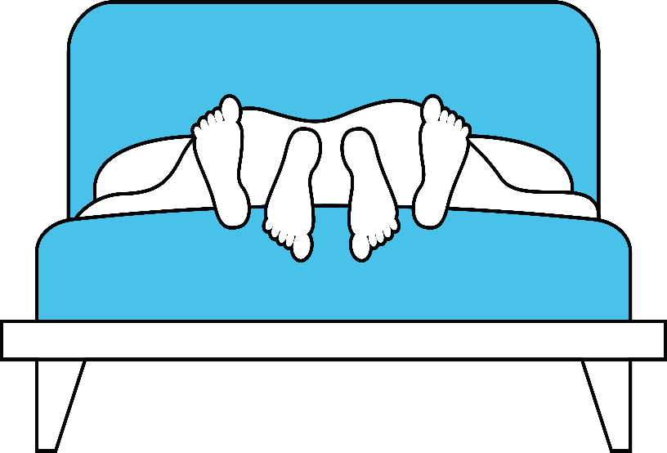
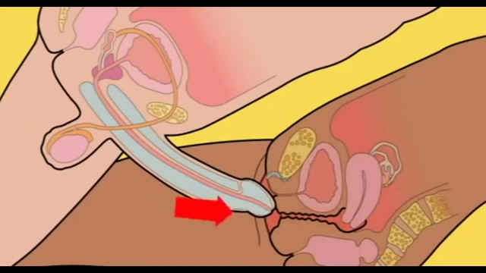
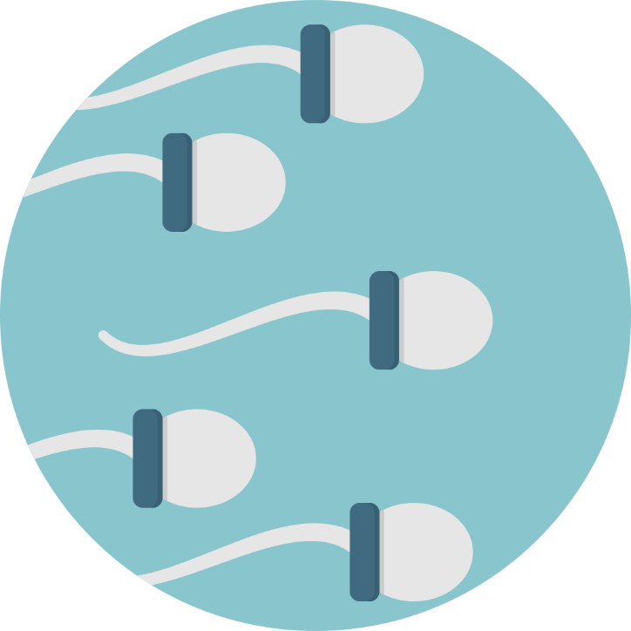
Sometimes when people are having sex the penis gets stiff and the vagina gets slippery.
When an adult couple are in a relationship they may want to have sex. This is when they touch each other in a sexual way and it feels pleasurable.
After a while a liquid (semen) is pushed out of the end of the penis. It has millions of tiny sperm in it.
Now the vagina can take the penis being inserted into it. It should feel nice.
Notes:
Explain that actually most of the time people have sex for pleasure and as a way of expressing their feelings for someone who they are very close to.

Slide 17
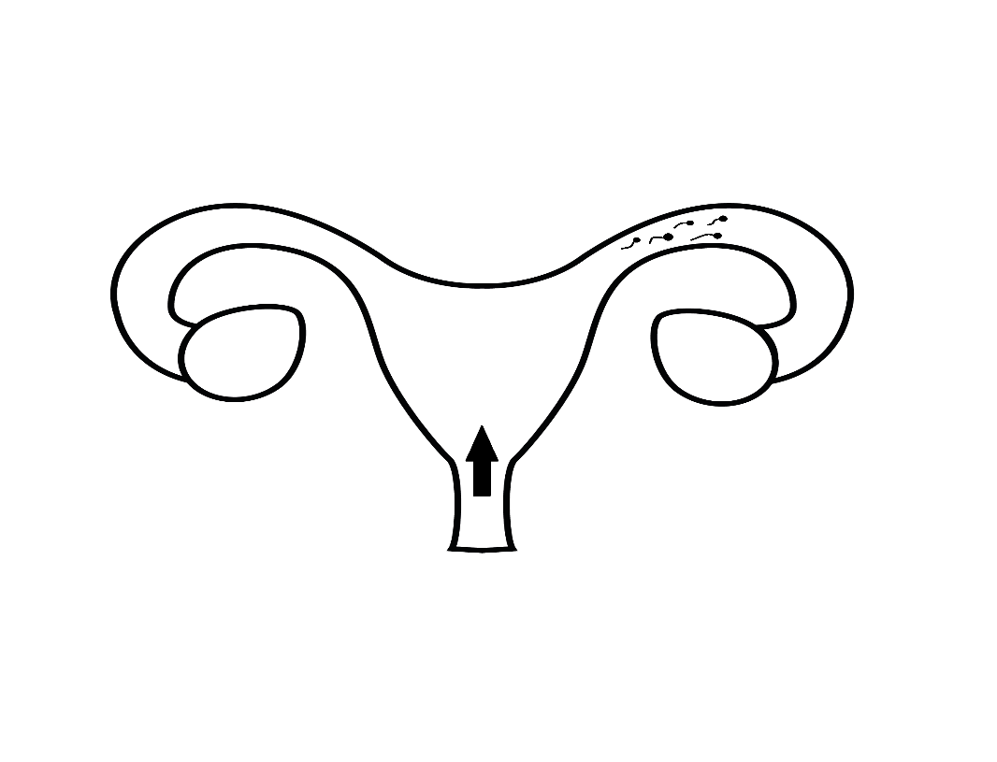
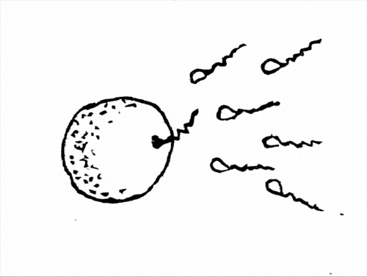
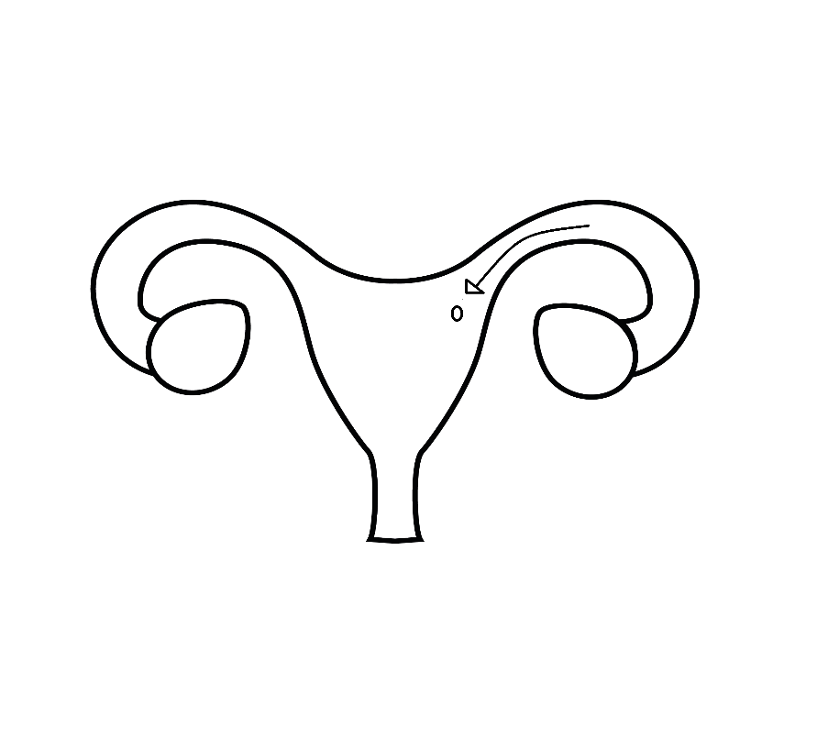
If there is an egg in the fallopian tube, one sperm will join up with it. The egg is now fertilised.
The sperm swim up the vagina, to the womb and into the fallopian tubes.
This is the start of pregnancy. The baby will grow in the womb for nine months until it is born.
The fertilised egg travels towards the womb. It implants in the womb and starts to grow.

Slide 18
Is this the only way someone can become a parent?
No, some people may not be able or not want to have a baby this way. They may adopt a child or have help from a doctor to become pregnant
Notes:
Key Message
Some people can’t get pregnant through having sex or do not want to have a family this way. They might choose to adopt a child (legally make a child a member of their family because they can’t be looked after by their biological family). They also might choose to have help from doctors to become pregnant.
Discuss some of the reasons people might not want / be able to have children at particular moments in their lives: studying, getting to know each other still, have already had children and don’t want any more, or may not be able to have any more etc. But they may still want to have a sexual relationship with their partner
Remember that families come in all different shapes and sizes. Some people might have two mums, two dads, a single parent, live with their wider family, or foster parents.

Slide 19
Summary
Everyone’s bodies are different, but genitals are broadly split into; girls, and those with a vulva, and boys, and those who have a penis and testicles.
It is not wrong or rude to know about bodies and how they work. We all have them.
People have reproductive organs so it is possible to get pregnant and having a baby

Slide 20
Where to go for help or questions
An adult you trust at home or school Come and speak to the facilitator after a lesson
Childline 0800 1111
https://www.childline.org.uk/

Slide 21
Thank you for listening
We hope you enjoyed it!
Do you have any questions?

